Slide 1

Apparel Fashion Web App
By SHIVANI SAINI Roll No: 1705214040 MCA (VI Semester)
Session 2019-20
Department of Computer Science and Engineering Institute of engineering and Technology, Lucknow

Slide 2
Content
ABSTRACT
INTRODUCTION
PURPOSE
FLOW OF APPLICATION
ABOUT DATASET
MODEL IMPLEMENTATION: IMAGE CLASSIFICATION
MODEL SUMMARY
MODEL FITTING
FLOW CHART OF WEB APPLICATION
FLOW CHART OF CNN MODEL
OUTPUTS
FUTURE SCOPE
ADVANTAGES OF WEB APP
CONCLUSION

Slide 3
abstract
The main objective is to predict the apparel name of the inserted image. In this project, I have created the Apparel Fashion Web App, which will be used to predict the name of the apparel. I have gained the experience of machine learning libraries with the huge data set of Fashion MNIST, by creating neural network classifier for prediction of apparel.

Slide 4
introduction
Recent advances in deep learning have triggered a variety of business applications based on computer vision. There are many industry segments where deep learning tools and techniques are applied in object recognition to make the business process much faster. The apparel industry is one among them. By presenting the image of any apparel, the trained deep learning model can predict the name of that apparel and this process can be repeated at a very much faster speed in order to tag thousands of apparels in very less time with high accuracy

Slide 5
purpose
The purpose of this project is to focus on Fashion Image Classification. Nowadays, many e-commerce companies such as Asos- EU 1, Farfetch 2 or Zalando 3 provide access to the data of their products in stock including item –metadata and images.
Fashion image classification is simple web application of apparel detection, which takes input apparel image and predict that from which class it belongs. Clothing and apparel retrieval has been addresses to find clothes similar to a photograph or a given style. The main challenge these studies faced was the definition and extraction of relevant features to describe the semantic content of the images with respect to the high variability and deformability of clothing items Convolutional Neural Networks is used to train a distance function which can be used to asses similarities between fashion images.

Slide 6
Flow of Application
In the left hand side of the given image, we have client side application such as web browser, we will upload the image on the web browser using upload button, and this goes to the server by using TCP/IP network and stored in the server.
After that Deep Convolution Neural Network model which is also stored in servers take the image of the apparel as input tries to extract the features of the image using various layers like Convolution, Max Pooling, Dropout, Flatten etc.
And provides prediction that which apparel belongs to which class. It would be in the text format and it will send back to the client and predict the Fashion Tag

Slide 7
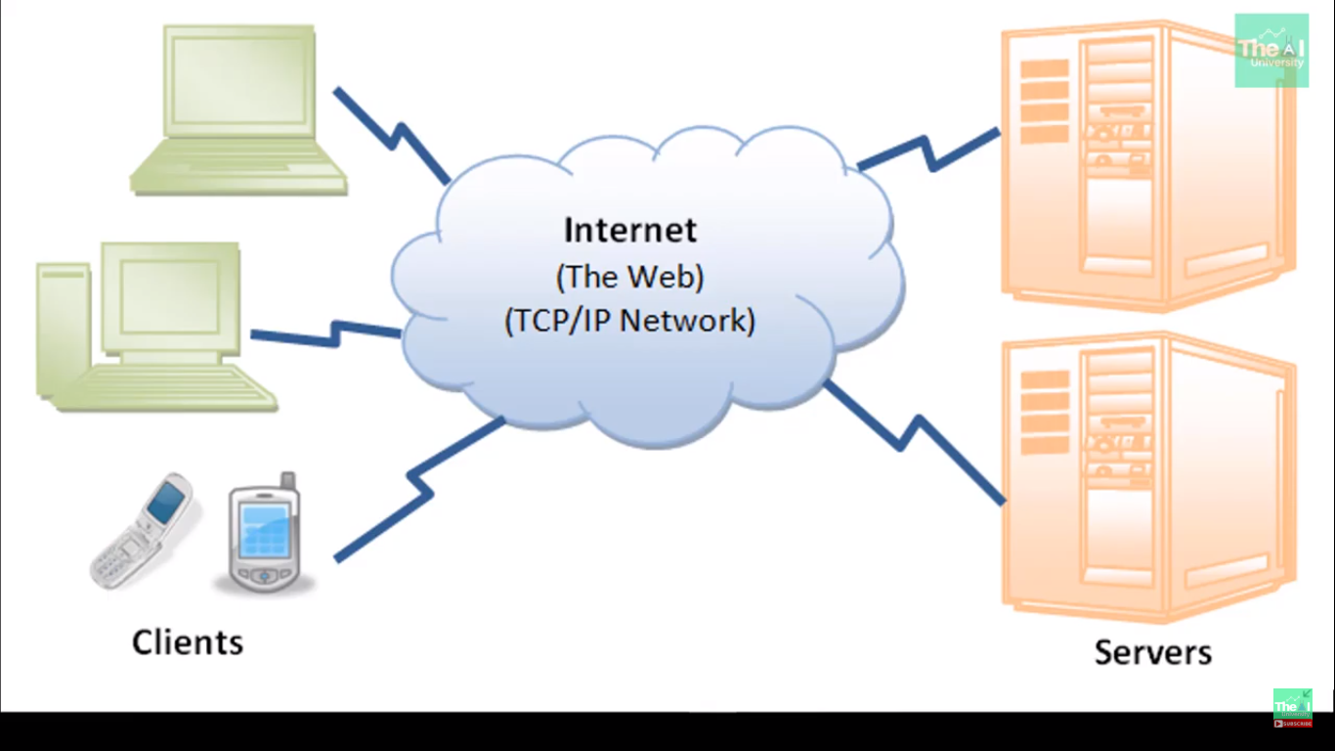

Slide 8
Dataset
For Fashion image classification, I have used Fashion –MNIST dataset, consisting of a training set of 60,000 examples and test set of 10,000 examples. Each image is a 28 X 28 grayscale image, associated with a label from 10 classes.
I have used the Fashion MNIST data set that is publicly available on Kaggle. It consists of a training set of 60,000 example images and a test set of 10,000 example images. Each image in the dataset has the size 28 x 28 pixels.
LABELS
Each training and test example is assigned to one of the following labels:
• 0 T-shirt/top • 5 Sandal
• 1 Trouser • 6 Shirt
• 2 Pullover • 7 Sneaker
• 3 Dress • 8 Bag
• 4 Coat • 9 Ankle boots

Slide 9
Classification model image classification
Image Classification pipeline can be formalized as follows:
Input dataset named as fashion- MNIST dataset, which consist of 60,000 training images and 10,000 testing images.
Then , I used that training set to train the classifier to learn what everyone of the classes looks like.
At the end, I evaluated the quality of the classifier by applying it to testing dataset.
Creation of model:
- I have created 3 layers Convolutional Neural Network for accuracy.
- CNN Sequential model, I have used here 2D convolutional layer, this layer created a convolutional kernel that is convolved with the layer input to produce a tensor of outputs. When using first layer in a model, provide the keyword argument input_shape as tuple of integers, which does not include the batch axis. In my case it is (28, 28, 1).

Slide 10
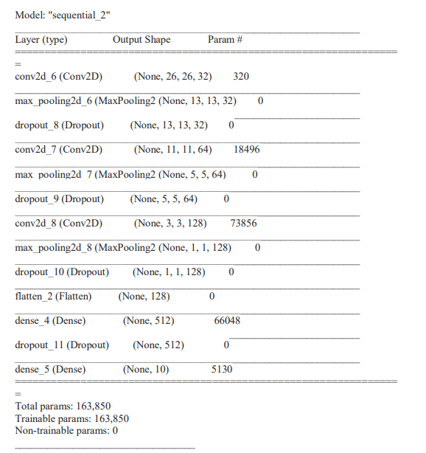
Model summary

Slide 11
Model fitting
Compilation is the most important part of the model.
So, during creation of model I compiled the model using arguments:
Optimizer: keras.optimizers.adadelta()
Loss function: Categorical_crossentropy
Metrics used: Accuracy.
ACCURACY VALUE IN THIS CASE:
accuracy in my case is 60.68%.
LOSS VALUE IN THE CASE:
loss value in my case is 10%.

Slide 12
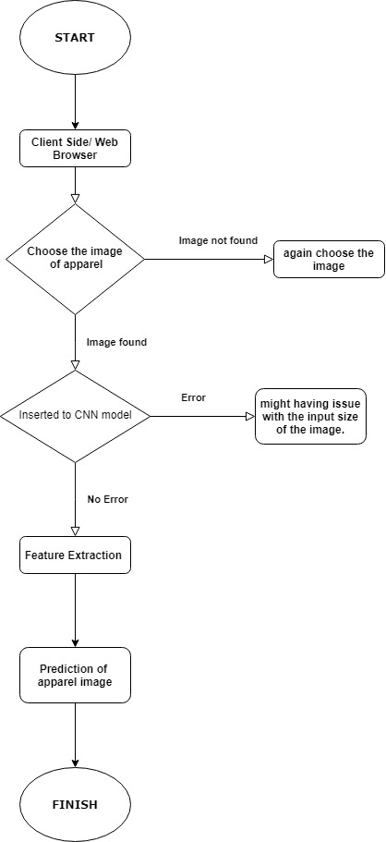
Flow Chart of Web application

Slide 13
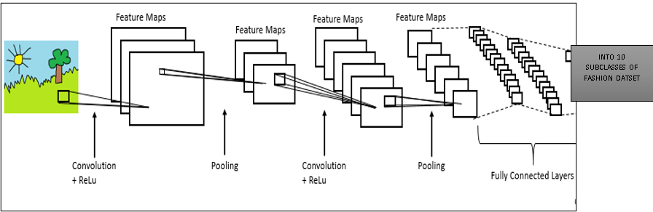
Flowchart of deep cnn

Slide 14
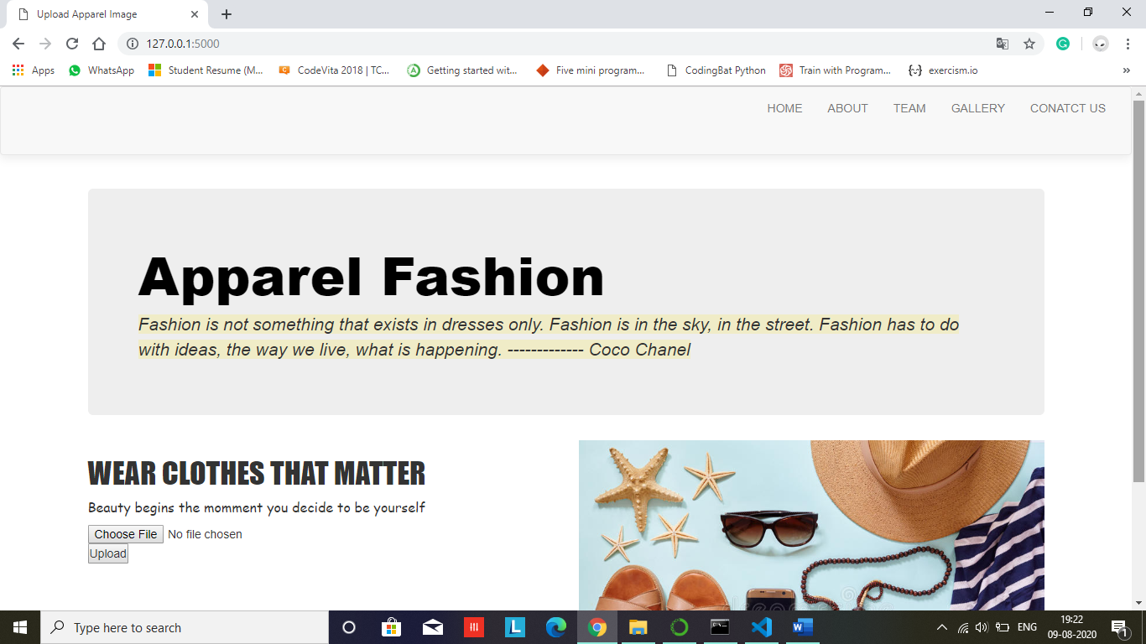
Output: first page of web app

Slide 15
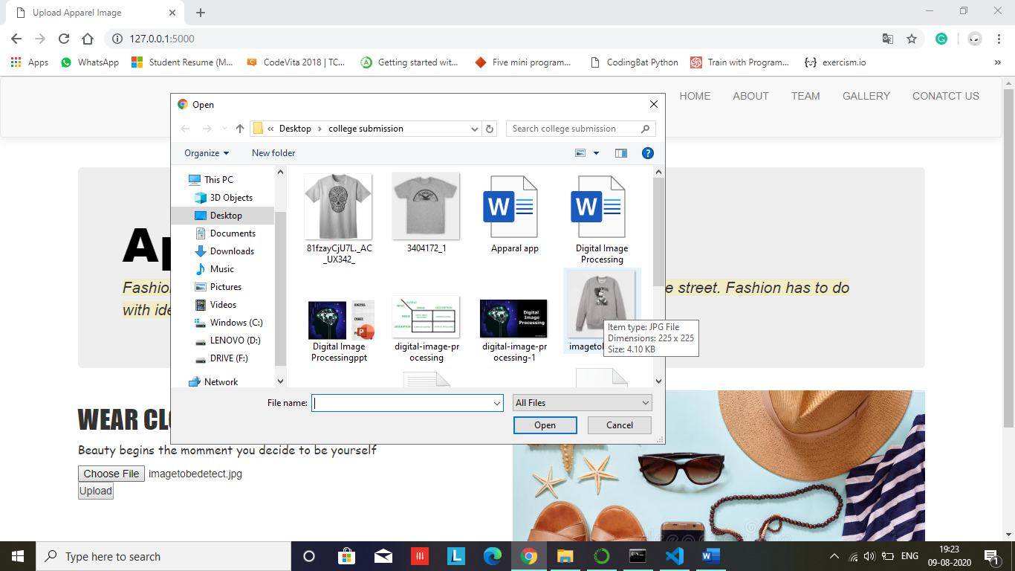
Here, we choose the file of image:

Slide 16
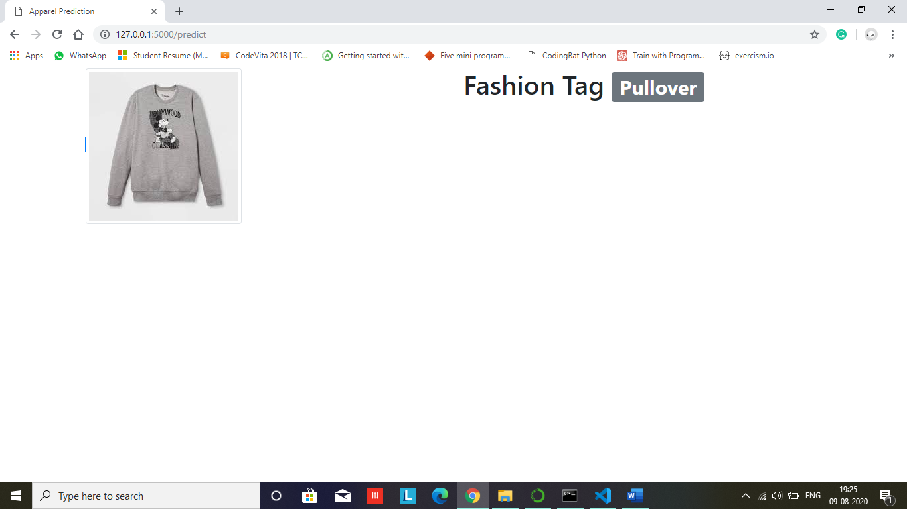
First, I have selected image of pullover, and its predicted corrected.

Slide 17
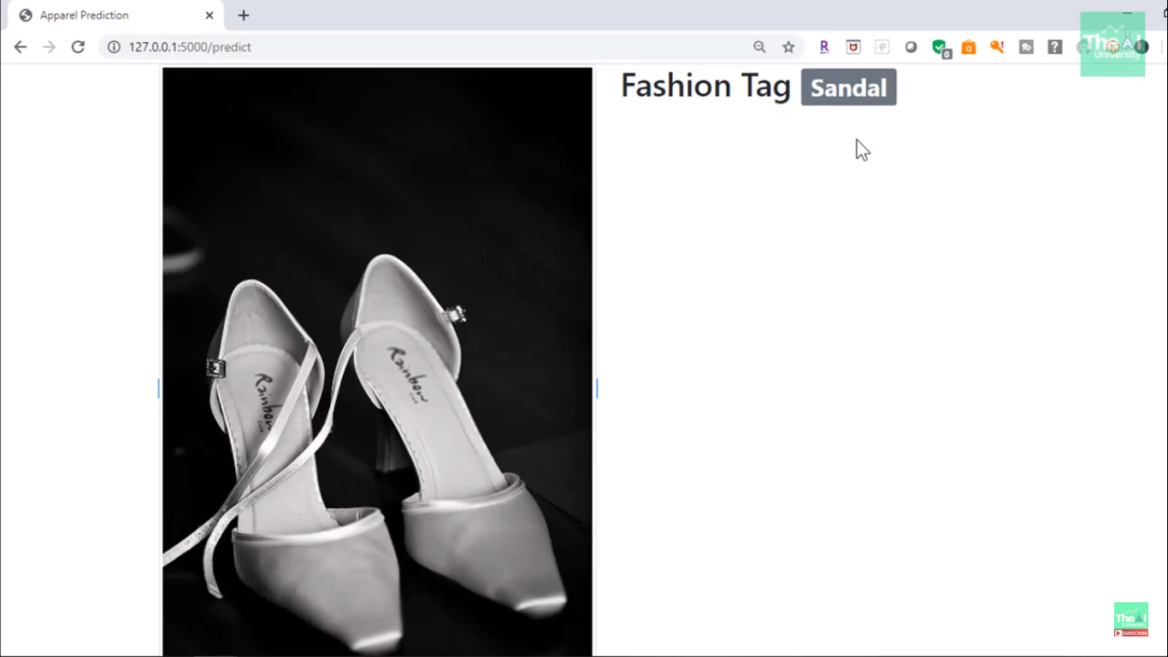
Second, I have selected the image of sandal, and it again predicted correct.

Slide 18
Future scope
The future of Fashion e-Commerce lies with mobile apps.
An already known but unspoken fact was recently confirmed by a data release from google, that the future of retail belongs to mobile commerce.
1 in 4 video viewers visited YouTube on their smartphones for aid in their shopping decisions. A consumer may not always have desktop in their vicinity for quick access but a Smartphone solves that issue being the one device that stays connected 24 * 7 and is always and along with being in reach. It perfectly bridges the physical experience of retail stores with the online experience and is the ideal medium for a brand to communicate directly with its consumer base. Fashion industry is one sector that identified this potential early on.

Slide 19
Advantages of apparel detection:
Apparel detection app help in choosing clothes
This small implementation of apparel detection can be implemented with other fashion app to categorize the clothes.

Slide 20
conclusion
In this study we presented an empirical evaluation of different Convolutional Neural Network (CNN) architectures concerning their performance in different tasks in the domain of fashion image classification. The experiments indicated that despite the large amount and high quality of provided fashion images, pre-trained and fine-tuned models outperform those which were trained on the given collections alone. Future work will concentrate on analysing models on a scale of two million images.

Slide 21
Thank you!!

